Slide 2
Assignment 1: Analysis of Bank Filings Data – Data Wrangling and Exploratory data analysis using Tableau Case Study

Slide 3
Part 1: Analyzing Banks with assert values greater than $10 billion
1. Data into single CSV –
Libraries used :
BeautifulSoup
Mechanize (Background Navigator)
CSV
Urllib
Sys

Slide 4
Steps – Unstacked version
Open URL using mechanize
Find table ‘datagrid’
Create a final and temp list to write to CSV and writing to list respectively
Fetch first ‘table header’ and all ’table rows’
Using regex to remove $ and , symbols from amount
Add to final list
Looping thought rows and adding data to temp
Open , Write to CSV file

Slide 5
Steps – Stacked version
Create a result_csv file
Loop through all the created csv files
Matching bank name against result_csv
If found, append a temp list with result_csv data and append current bank assert
else
If not found, create a new temp list, append as many number of ‘0’ as result_csv rows, current bank assert
Add temp to final list
Open and write final list to csv
Close CSV

Slide 6
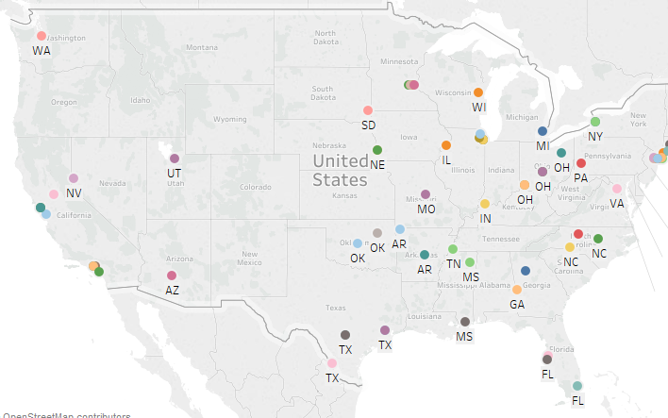
US Map Plotting
Creating a US map with all plotted banks

Slide 7
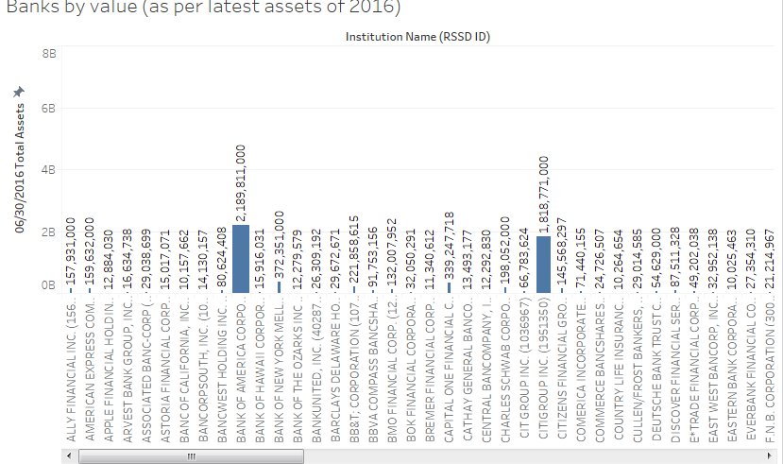
Dashboard 1 - Histogram
Mapped bank name vs Quarter data

Slide 8
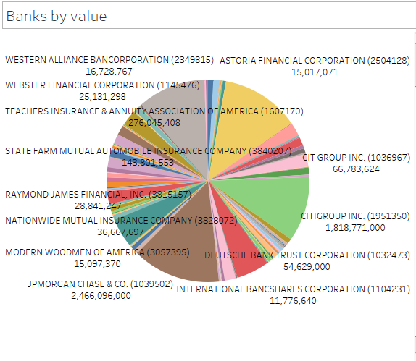
Dashboard 1 – Pie Charts

Slide 9
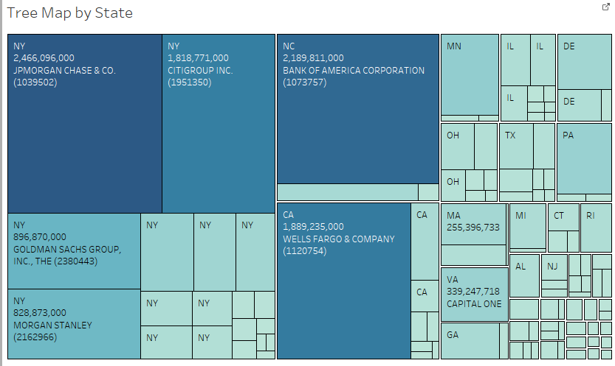
Dashboard 2

Slide 10
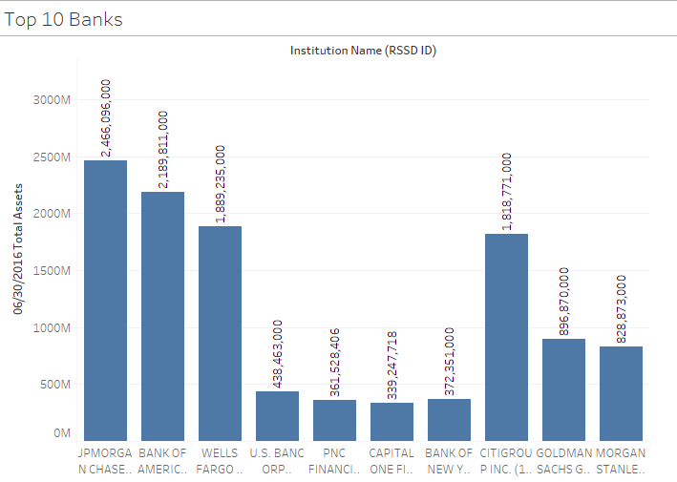
Dashboard 3 – Top 10 banks

Slide 11
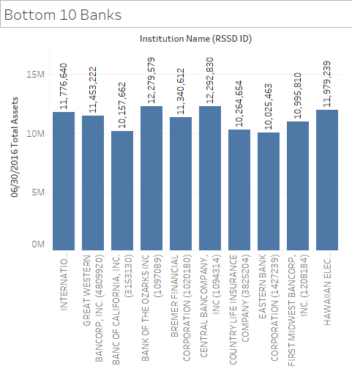
Dashboard 3 – Bottom 10 banks

Slide 12
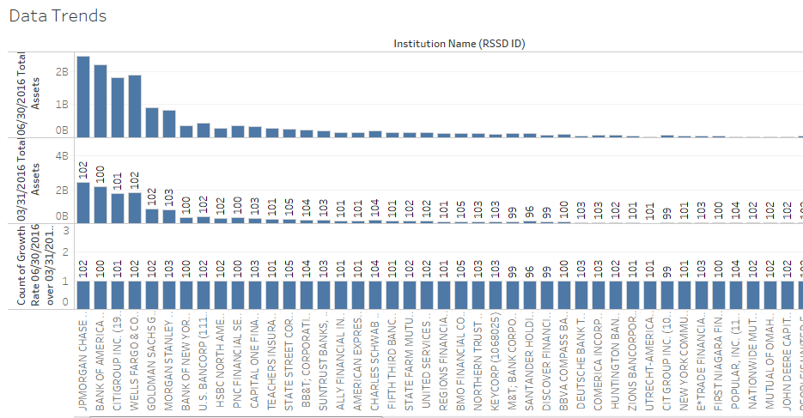
Dashboard 4 – Data Trend

Slide 13
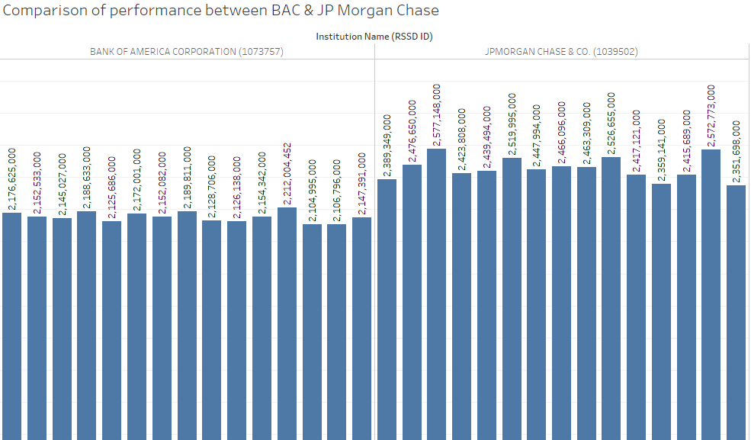
Dashboard 5 – Compare two banks

Slide 14
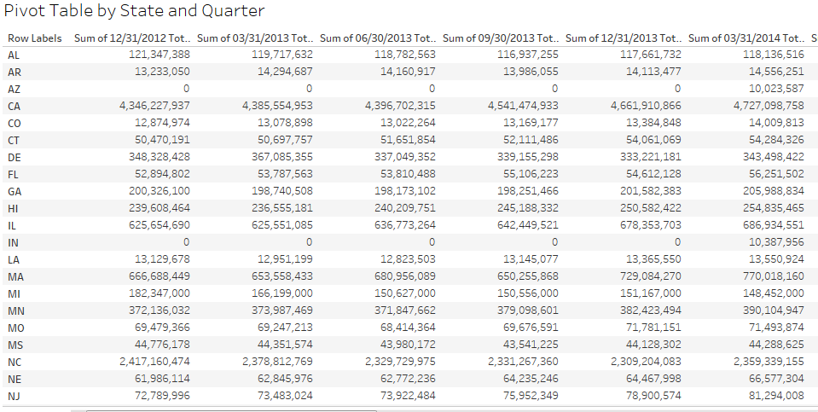
Dashboard 6 – Pivot table

Slide 15
Part 2
Packages Used
  request
  bs4
  PyPDF2
  re
  os
  csv
  openpyxl
  shutil

Slide 16
Steps
  Using requests package get the page.
  Using beautiful soup package get the DOM text of the web page.
  Get all the anchor tags of the page using beautiful soup.
  Loop through the anchor tags and get all the pdf’s in anchor tags with href having substring PeerGroup_1.

Slide 17
  Loop through all the pdf’s downloaded and store the names of the pdf’s in a List
  Loop through each PDF and create CSV files for each page of a the PDF file and dump all the CSV created for a the PDF into a folder.
  While looping through the PDF find out the year and Quarter of the PDF and create the directory as Peer1_YEAR_QUARTER.

Slide 18
  Create an excel workbook using openpyxl package.
  For each directory, create a single workbook and add each csv as a separate sheet into the workbook.
  Delete all the folders containing the CSV using shutil package.

Slide 19
Data Review
  Since most of the data in the Pdf doesn’t follow a structure, most of the data is unformatted in the beginning. The PyPDF2 and re packages are extensively used to find recurring patterns to determine individual fields.
  Using regular expression to find the end of a line, add each line to csv with ‘,’ replacing the spaces(3 or more) between characters to identify each field.

Slide 20
Normalize
  While looping through all the csv files created for each individual pages of pdf. The ordering of files was page1,page10, page11 since the page numbers were considered as strings.
  In order to loop through each page in sorted order, sorted function is used and is passed a lambda expression to sort the filenames, making sure all the workbooks follow the same sorting order of pages.
  Ref: http://stackoverflow.com/questions/23724653/ordered-os-listdir-in-python

Slide 21
Part 3
Visualization using tableau
1. Extracted data by the two excel files.
2. Created worksheets for each graph using the data.
3. Created dashboards for graphs created in worksheet.

Slide 22
Data extraction
Extracted data by importing two excel files by clicking on data->new data source.
Gathered data from the two data sources

Slide 23
Worksheet creation
Created graphs on each worksheet.
Drag and dropped each dimension against measures.
Created two graphs- a bar graph and a treemap for each graph representation.
Two different graphs present a nice visualization of the data being presented.
Merged worksheets into dashboards.

